Slide 1

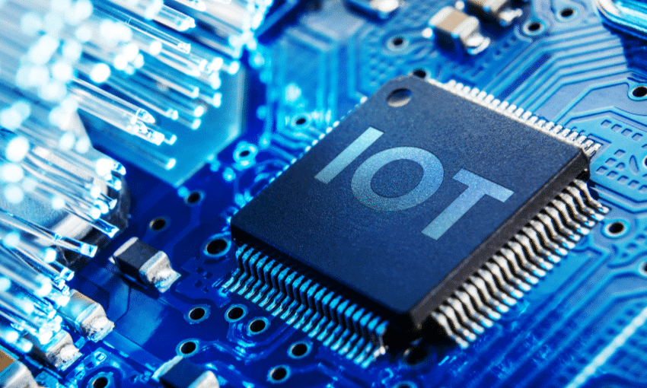
Internet Of Things Internship at
Edify Techno Solutions
Present By: Gowri Sankari.K

Slide 2
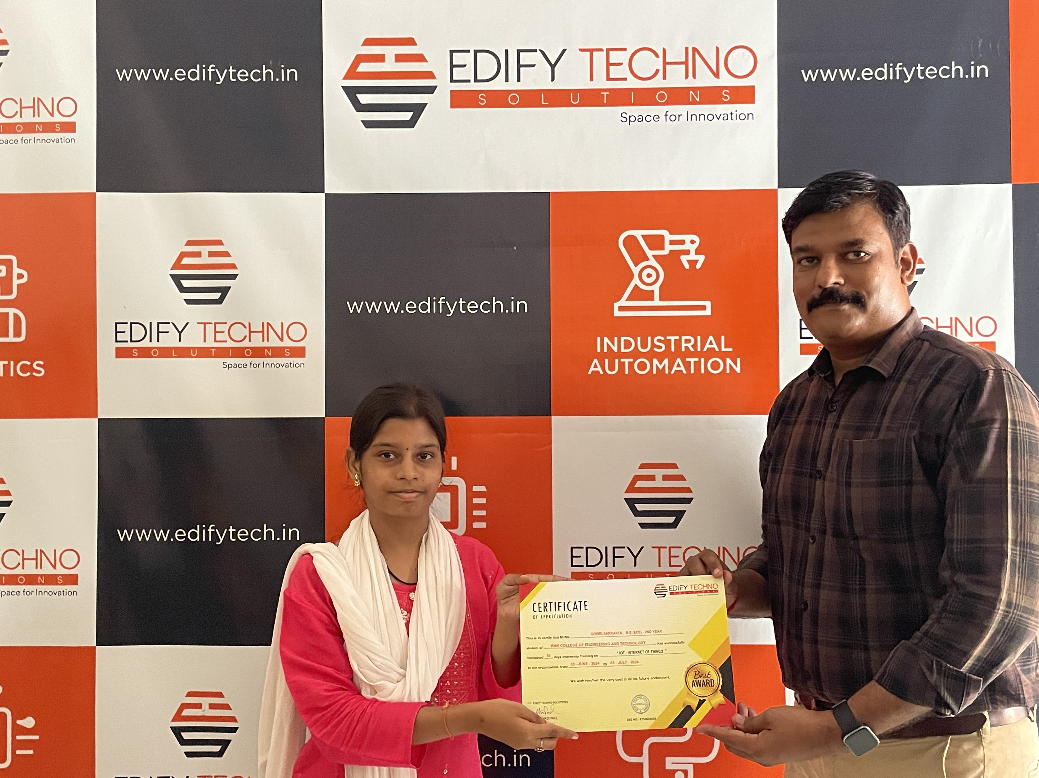

Slide 3
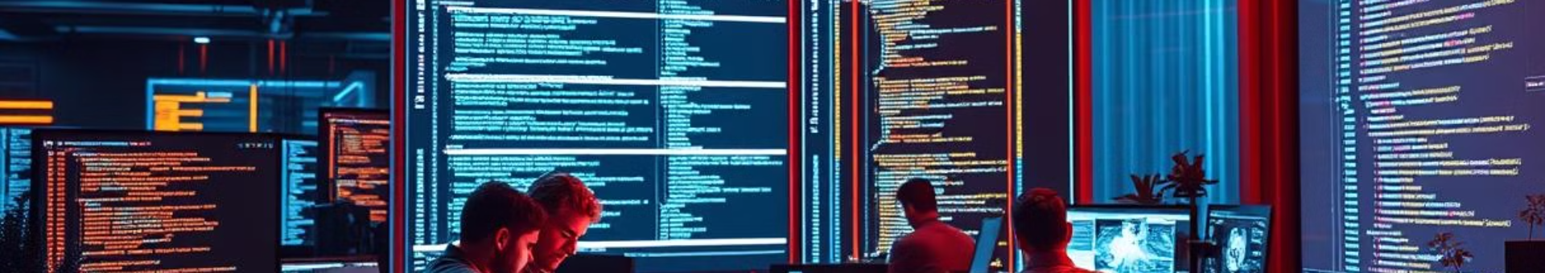
About Internship
Edify Techno Solutions
Internship Experience
Edify Techno Solutions is a technology company that focuses on providing innovative solutions in various domains, particularly in the Internet of Things (IoT), software development, and IT services.
I completed an internship at Edify Techno Solutions , where I gained hands-on experience in the Internet of Things (IoT) domain. My primary objective was to design and implement IoT solutions to enhance the efficiency of connected devices.

Slide 4

Internship Learned
Overview Of IOT And High Level Architecture
Setting Up IOT Work Flow
SOFTWARE(Arduino1.8.19)
WIFI Theory
Micro-Controller Programming Using Arduino Platform
Building IOT Application Using ESP8266
IOT Cloud Infrastructure (BLYNK SOFTWARE)
Performance And Security In IOT
Real Time Demo

Slide 5
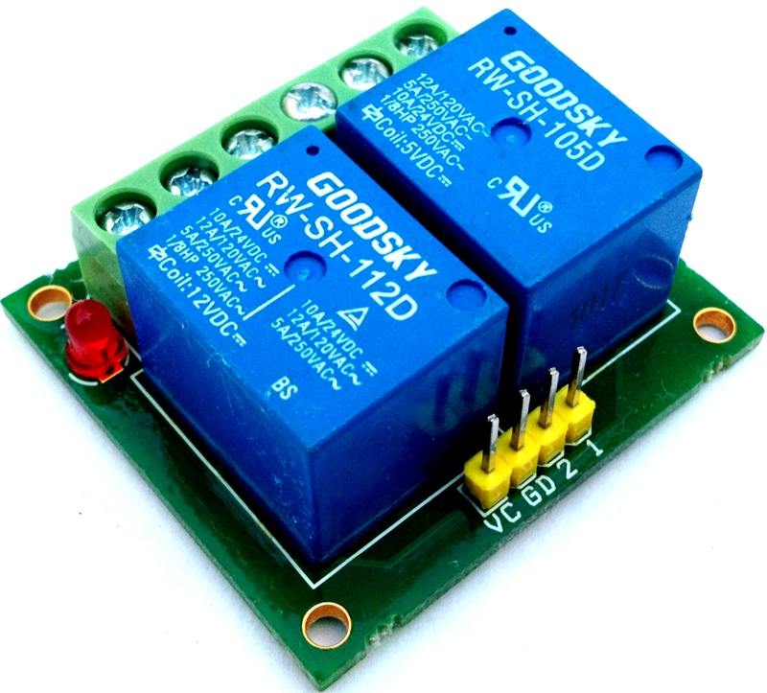
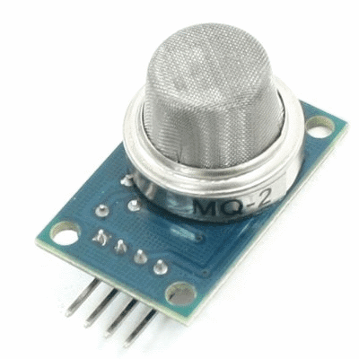
SENSOR
It is a device that detect and measure physical properties and environmental condition
It converts the measurement into electric signal or data for processing
TYPES OF SENSOR
FIRE SENSOR
LDR(LIGHT DEPEDENT RESISTOR)
HUMIDITY SENSOR
IR(INFRARED SENSOR)
GAS SENSOR
OUTPUT COMPONENTS
BUZZER
MOTOR
LCD DISPLAY
LED LIGHT
MOTOR

Slide 6

ARDUINO UNO
What is Arduino Uno:
Popular microcontroller board based on ATmega328P.
Ideal for electronics projects, especially for beginners and hobbyists.
Operates at 16 MHz clock speed
8-bit microcontroller
How Arduino Works:
Programmed via Arduino IDE using C/C++.
Interacts with components like sensors, LEDs, and motors.
Why Arduino:
User-friendly, versatile, and supported by a large community.
Suitable for a variety of projects, including IoT and prototyping.
Pins Description:
14 digital I/O pins (6 PWM), 6 analog input pins, 5V/3.3V power pins, and serial communication pins.

Slide 7
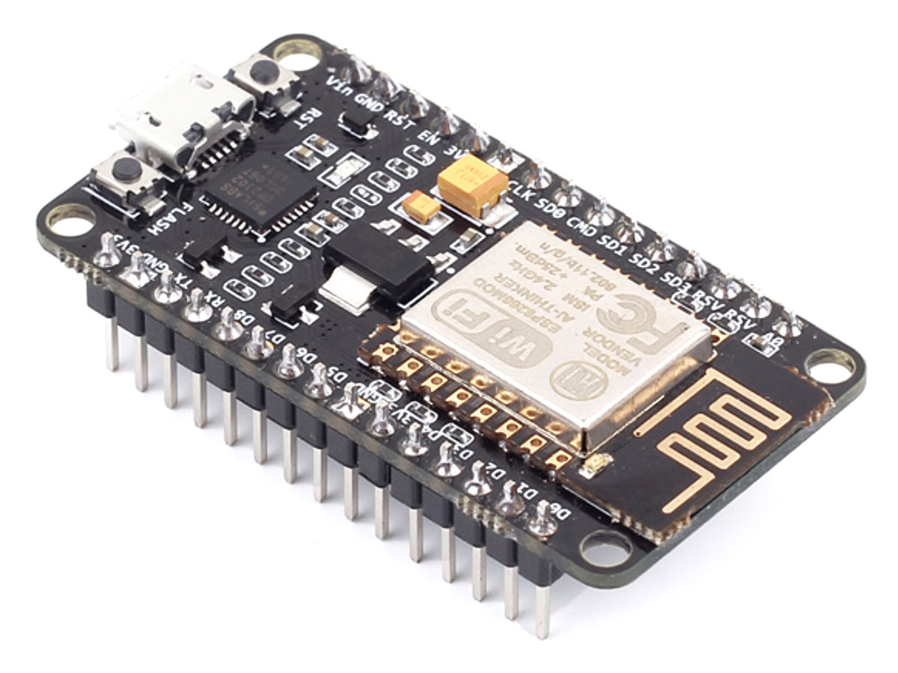
Applications:
IoT, prototyping, education, robotics, and home automation.
Cost:
Typically $20-$30, making it cost-effective for its features
Advantages:
Easy to use, affordable, expandable, and open-source.
Disadvantages:
Limited processing power, no native internet connectivity, and memory constraints.

Slide 8
Boards | Arduino | ESP32
CPU | ATmega328P | Tensilica Xtensa LX6
RAM | 2KB | 520KB
Internet Connectivity | Ethernet Shield | both Built-in WIFI & Ethernet port
Bluetooth Connectivity | not present | present
Software | C/C++ languages | micro python, Python, C++
Operating System | No | Required (Raspbian (Debian-based), Ubuntu)
Operating Voltage | 5v | 3.3v
Operating Frequency | 16 MHz | Up to 240 MHz
Flash Memory | 32 KB | Typically 4MB (can vary)
Cost | cheaper | expensive
Family | Atmega Family | ESP Family
Ease of use | Easy and Simple for beginners | Complex and Hard to learn for beginners
GPIO | 14 (6 of which provide PWM output) | 34
Analog Input Pins | 6 | 18
DIFFERENCE BETWEEN ARDUINO VS NODE MCU

Slide 9
Light Dependent Resistor Code
Infrared Red Sensor Code
#define LDR A0
int a;
void setup(){
pinMode(LDR,INPUT);
Serial.begin(9600);
}
void loop(){
a=analogRead(LDR);
Serial.println(a);
delay(1000);
}
#define IR 2
int a;
void setup(){
pinMode(IR,INPUT);
Serial.begin(9600);
}
void loop(){
a=digitalRead(IR); Serial.println(a);
delay(1000);
}
SOFTWARE PART

Slide 10
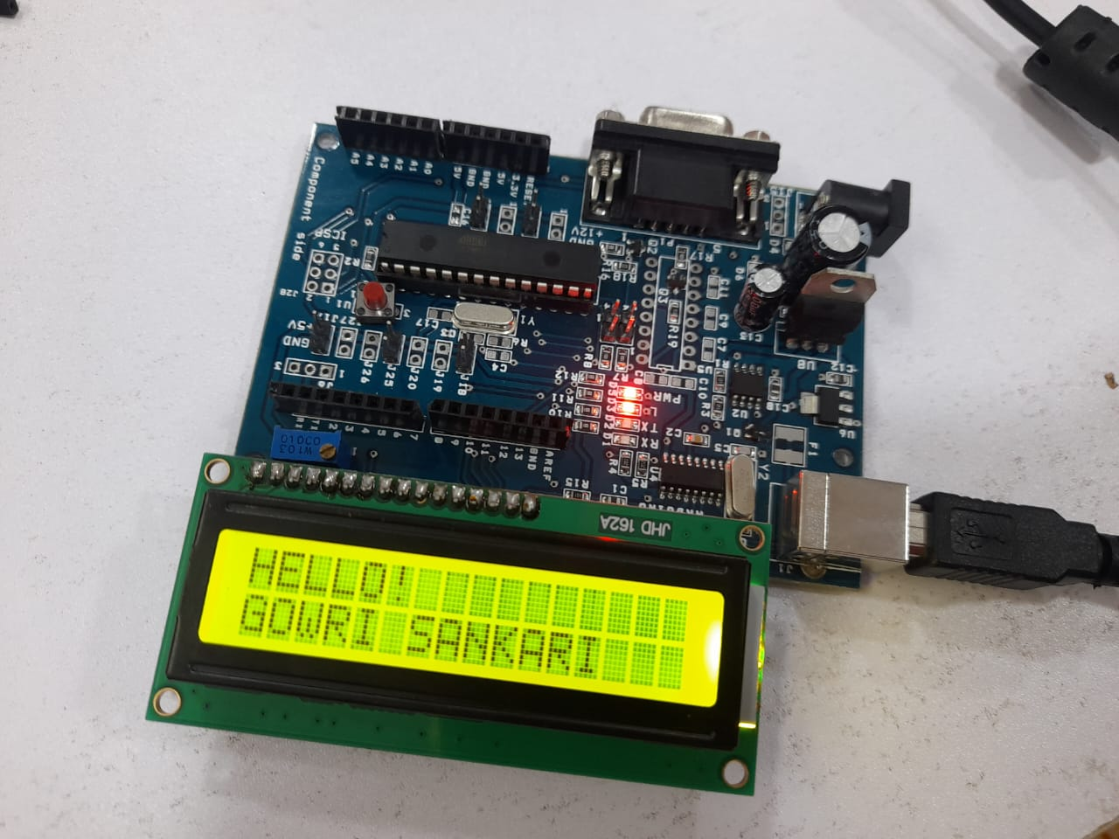
MINI PROJECTS
LDR SENSOR
IR SENSOR
FIRE SENSOR
LIGHT BLINK
IR SENSOR WITH LIGHT
IR AND GAS SENSOR TO DISPLAY THE RESULT IN LCD
RF(Radio Frequency)
WIFI MODULE

Slide 11

Internship Objectives
Hardware Integration
Integrated multiple sensors with Arduino and ESP8266
Developed practical hands-on skills in sensor interfacing
Software Development
Learned and applied Embedded C programming for hardware control
Enhanced coding skills for IoT devices
Data Management & Visualization
Gained experience in storing sensor data
Utilized Blynk software to visualize data in real-time
Created user-friendly interfaces for IoT monitoring
Conclusion
Comprehensive understanding of both hardware and software aspects of IoT systems
Hands-on experience in developing end-to-end IoT solutions

Slide 12
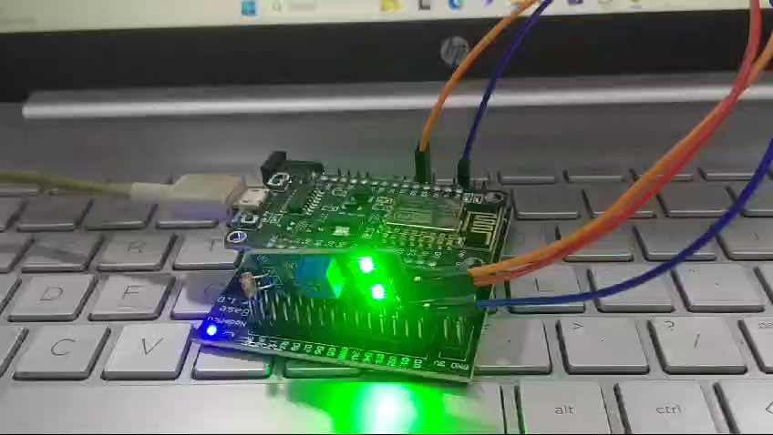

Slide 13


